Slide 1
Chapter 9 Motion

Slide 2
MOTION
An object is in motion if its distance from another object is changing.
To decide if you are moving, you need a reference point.

Slide 3
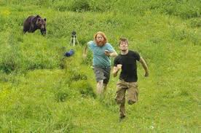
REFERENCE POINT
A place or object used for comparison to determine if something is moving.
EX: Tree, sign, building.
An object is in motion if it changes position relative to a reference point.

Slide 4
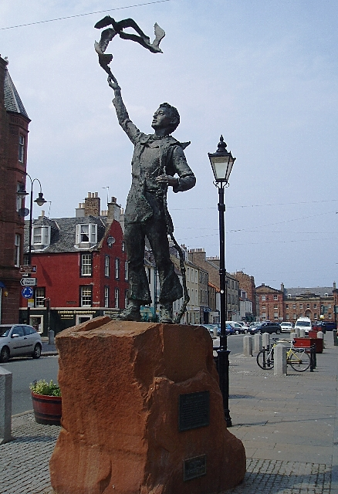

Reference Point to describe position
An object or place that makes it easier for someone to find a position.
Family picnic at park: Tell grandma it is the 1st picnic table closest to the statue.

Slide 5
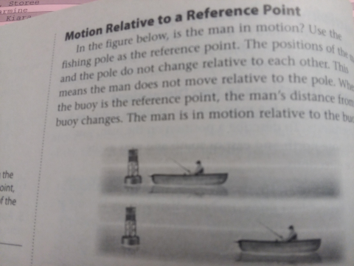
DIRECTION

Slide 6
Reference Point Moving
If reference point is moving, you will find it difficult to determine which direction you are moving or even if you are moving.
Ex: 2 buses at stop light, the bus you are on looks like its moving backwards…..

Slide 7

DISPLACEMENT
The difference between the initial (first) position & the final position of an object.
Baseball: initial position for the batter is HOME PLATE. On a hit, the batter’s final positon is first base.

Slide 8
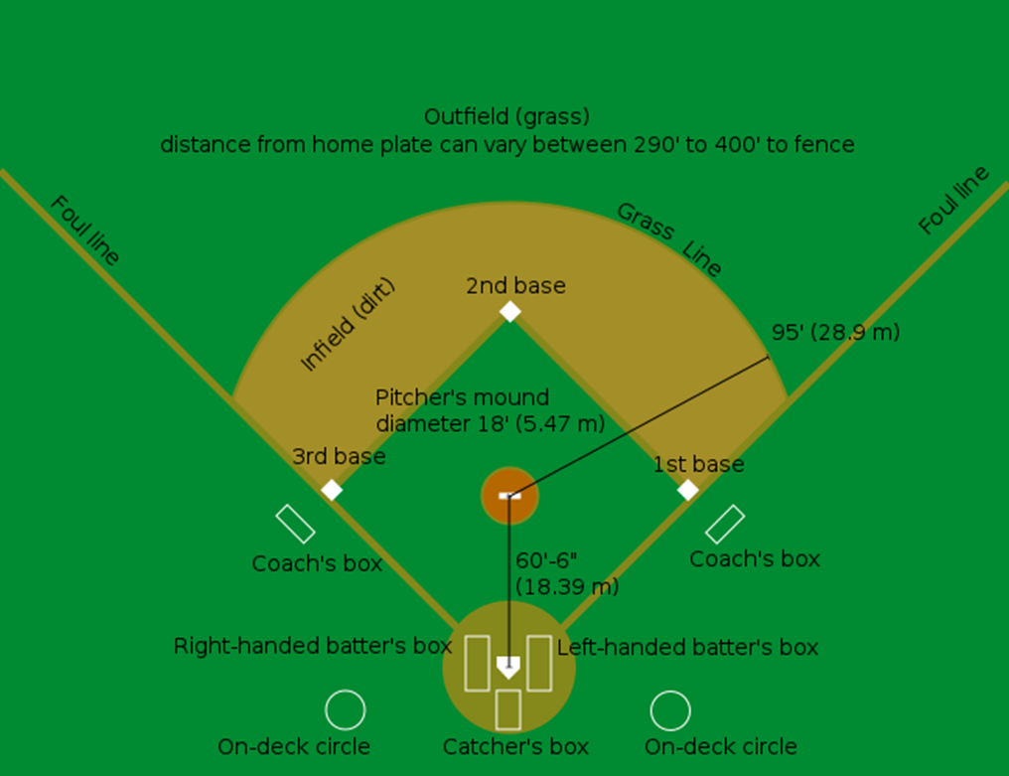
90+90+90 or
270ft
90+90 or 180ft
90+90+90+90
Or 360ft
90 ft

Slide 9
MEASURING
Can use units of measurement to describe volume, weight, & length precisely. 2 systems:
English (Linear) System, & International or Metric System.

Slide 10
International System of Units (SI)
Scientists all over the world use the same system of measurement (SI) (metric) so they can communicate clearly.
Scientists use SI units to describe certain measurements. Distance = Length. Meter (m) km

Slide 11
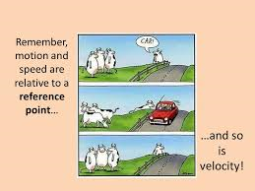
Review Motion or No Motion?
1.

Slide 12

2.

Slide 13
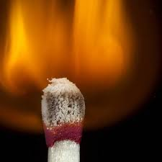
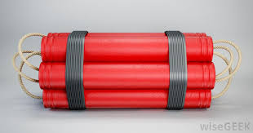
3.

Slide 14
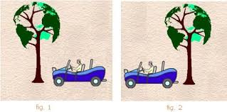
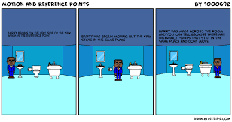
4.
3

Slide 15
5.
Using what you know, write a sentence identifying 2 things you need to include when talking about an object’s motion.

Slide 16
6.
When a reference point is changed, the description of the _________ & the _______ to the object also must be changed.

Slide 17
A. Describing Position
1. A(n)_______ is a starting point you choose to describe the location, or position, of an object.
2. A(n)______ is an object’s distance and direction from a reference point.
3. A complete description of a position includes a distance,
a(n)_______ , and a reference point.
4. A good choice for a(n)______ is something that is easy to find.
5. If a reference point changes, the description of an object’s_____
will also change.

Slide 18
6. Changing a reference point does not change the actual ______of an object.
7. When you describe an object’s position, you compare its location to a _________ .
8. A reference direction can be described as a(n)______ direction.
C. Describing Changes in Position
1. is the process of changing position. It is always
described relative to a(n) _________.
2. It is possible to move with regard to one & stay
motionless with regard to another__________ .

Slide 19
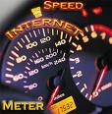

SECTION 2
SPEED AND VELOCITY

Slide 20
SPEED BASICS
If you know the distance an object travels in a certain amount of time, you can calculate the speed of the object.

Slide 21
SPEED
The distance an object travels per unit of time.
Speed a type of rate.
Rate tells the amount of change in one unit of time.

Slide 22
CALCULATING SPEED
SPEED = DISTANCE TIME
Speed of most moving objects is NOT constant.

Slide 23
SPEED
Cyclist travels 100 miles in 5 hours.
Avg. Speed = 20mph

Slide 24
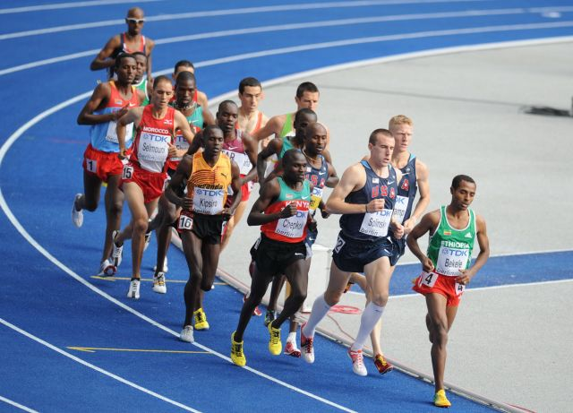
Constant Speed
The rate of change of position in which the same distance is traveled each second.

Slide 25

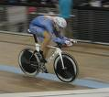
INSTANTANEOUS SPEED
The rate at which an object is moving at a given instant in time.

Slide 26
Graphing Motion
Can show motion of an object on a line graph, plotting distance versus time.
X axis (horizontal axis) = Time
Y axis (vertical axis) = Distance

Slide 27
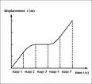
MOTION GRAPH

Slide 28
Changes In Speed on Graph
Slow down- downward curve
Stop- straight line
Speed up- upward curve

Slide 29
1.An Airplane is descending to land at the airport. During its descent it had to fly in circles until the landing was cleared of other planes. Explain what is occurring during each of the segments.

Slide 30
2) John left his home & walked 3 blocks to his school, as shown in the graph.
(1) What is one possible interpretation of the section of the graph from point B to point C?
(2) Where did John show an increase in speed?

Slide 31
3) Jen left her house & drove to school in the morning, as shown in the graph. On her drive to school, she realized that she forgot her bookbag & had to return home before driving back to school for a 3 hour class. Explain what is happening during each part of the graph:
1.AB
2.BC
3.CD
4. DF

Slide 32
4) The graph shows Marie’s distance from home (A) to work (F) at various times during her drive.
a Marie left her briefcase at home & had to return to get it. State which point represents when she turned back around to go home & explain how you arrived at that conclusion.
b Marie also had to wait at the railroad tracks for a train to pass. How long did she wait?

Slide 33
5)A bug travels up a tree from the ground over a 30-second interval. It travels fast at first then slows down. It stops for 10 seconds, then proceeds slowly, speeding up as it goes. Which sketch best illustrates the bug’s distance (d) from the ground over the 30-second interval (t)?

Slide 34
VELOCITY
Speed in a given direction.
A thunderstorm traveling east at 25mph.

Slide 35
average constant direction distance horizontal
instantaneous steep time velocity
1. Speed is a measure of_____ the an object travels in a unit
Of _____ .
2. When a moving object’s change of position is equal in every second, it is moving at a(n) _______speed.
3. An object’s speed at any particular moment is its___ speed.
4. Its speed for the entire duration that it is in motion from one place to another is its_____ speed.
5. A(n)______ line on a distance-time graph shows a fast speed
6. A(n) ____portion on a distance-time graph shows a period of no motion.
7. The of a moving object includes its speed and_______ .

Slide 36
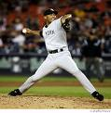

ACCELERATION
SECTION 3

Slide 37
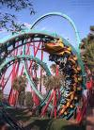

ACCELERATION
Refers to increasing/decreasing speed or changing direction.
Rate at which velocity(speed or direction) changes

Slide 38
Increasing/Decreasing Speed
Objects accelerate when they speed up. Car speeds after a red light turns green.
Objects accelerate when they slow down. Rolling baseball eventually stops rolling.
Objects accelerate when they change direction. Car turns.

Slide 39
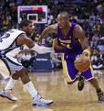
Calculating Acceleration
To determine the acceleration of an object moving, calculate the change in speed over a period of time.

Slide 40
ACCELERATION FORMULA
ACCELERATION =
Final Speed - Initial Speed
TIME
A = 40 m/sec. – 0m/sec.
            5seconds
            A = 8 meters/sec.

Slide 41
Units of Acceleration
Speed measured in : Meters per second (m/sec), Kilometers per second (km/sec).
Time measured in seconds.
Answer: m/s2 or km/s2

Slide 42

GRAPHING ACCELERATION
Speed-vs-time graph or distance-vs- time graph can be used.

Slide 43
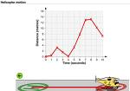
SPEED-VS-TIME GRAPH
Time on bottom (X axis), Speed going up (Y axis). A straight or slanted line shows acceleration
Not moving =
Straight line.

Slide 44
The Concept of Acceleration
1. Accelerating objects are objects that are changing their velocity. Name the 2 controls on a car that cause it to accelerate.
2. An object is accelerating if it is moving _____. Circle all that apply. a. with changing speed b. extremely fast c. with constant velocity
d. in a circle e. downward f. none of these
3. If an object is NOT accelerating, then one knows for sure that it is ______. a. at rest b. moving at a constant speed c. slowing down d. maintaining a constant speed

Slide 45
4.The rate of change of the speed of an object is called its ______. A) speed B)velocity C) acceleration
5. When an object is decreasing speed we can say it is
a.Accelerating b.Motionless c.Decelerating d.Stopped
6 Units of measurement used to label a quantity of acceleration are:
A) m2/sec. B)sec2/m. C)m/sec. D)m/sec2.
7 Acceleration is:
a.The distance between two dots.
b.The distance divided by time.
c.The rate of change in the speed of an object

Slide 46
8. An object is moving with constant speed. Describe two ways to change this motion that would cause the object to accelerate. Give an example of each.

